Slide 1
WaveScalar & TSP
Two Dataflow Architectures

Slide 2
WaveScalar

Slide 3
Background
Moore’s Law is Falling
Processor Scaling Wall
disparity between computation and communication performance
the increasing cost of circuit complexity
the decreasing reliability of circuit technology
Augment the program counter-driven von Neumann model

Slide 4
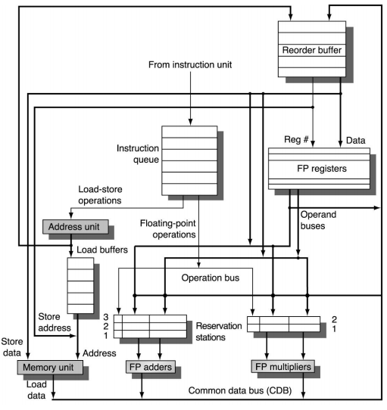
Motivation
RAW
WAR
WAW

Slide 5
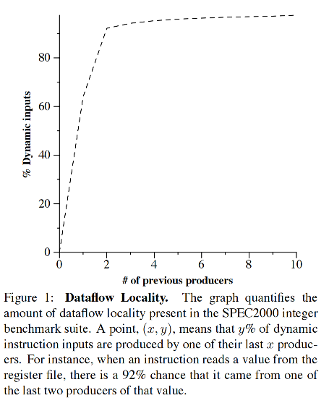
Motivation
Scaling up superscalar is hard
Circuit complexity, fast transistors, slow wires, communication，infrastructure
Von Neumann means sequential
Sequential fetch (PC) and memory
Untapped dataflow locality
predictability in the dynamic data dependencies
Notes:
In particular, modern
superscalar processor designs will not scale because they are built atop a vast
infrastructure of slow broadcast networks, associative searches, complex con_x0002_trol logic, and centralized structures.

Slide 6
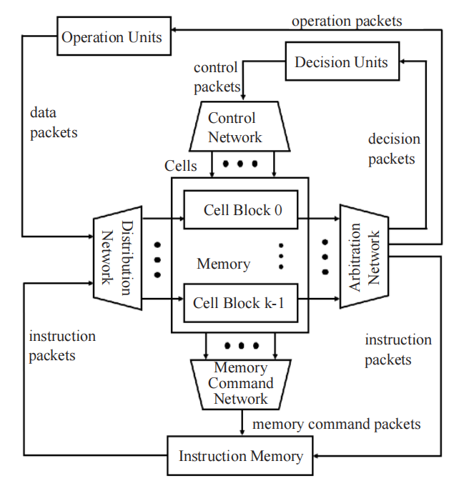
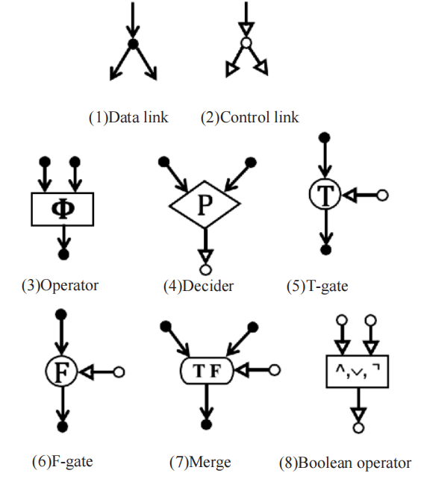
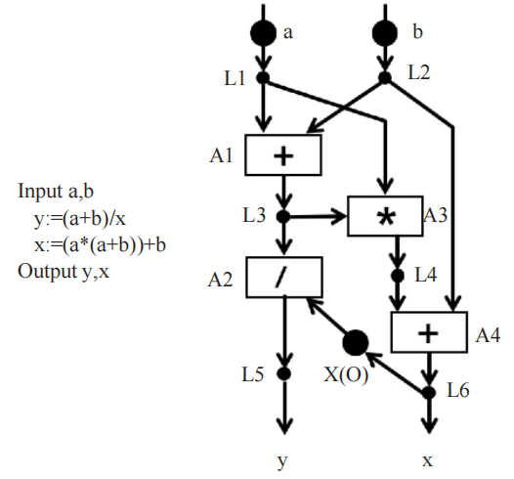
Prior Dataflow Architecture
Notes:
过去的都focus on 处理器的应用？
以往的数据流架构提供了它们自己的内存语义风格和数据流语言，这些语言通常不允许副作用、可变数据结构以及许多其他有用的编程结构。WaveScalar 解决了内存排序问题，允许以数据流方式高效执行用任何语言编写的程序，而无需依赖于冯·诺依曼式执行模型。
WaveScalar’s goal is to minimize communication costs by ridding the processor of long wires and broadcast networks.
Other recent attempts to build scalable processors, such as TRIPS [3, 9] and Raw [10], have extended the von Neumann paradigm in novel ways, but they still rely on a program counter to sequence program execution and mem_x0002_ory access,

Slide 7
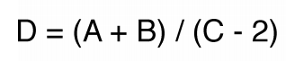
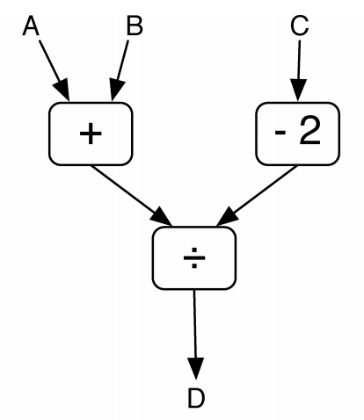
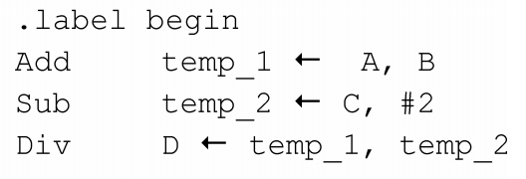
The WaveScalar ISA
Program Representation and Execution
Each node in the graph is an instruction
The arcs between nodes encode static data dependences
Using “←” to map
register names do not correspond to a specific architectural entity
the order of instructions does not affect their execution

Slide 8
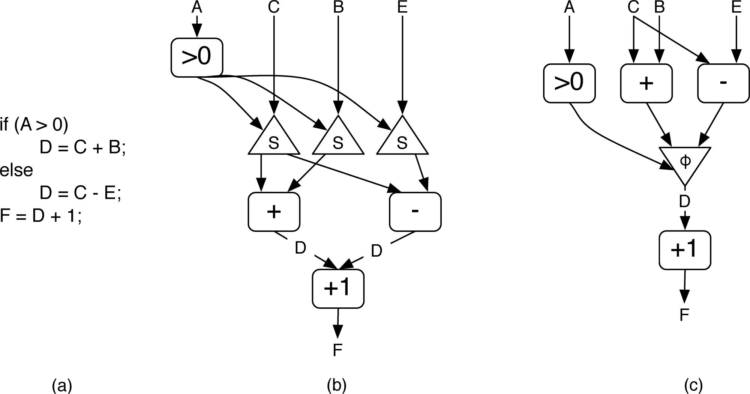
The WaveScalar ISA
Control Flow
Steer
predication and discard
Both cases must contain a control instruction for each live value
Notes:
Steer values into one part of the dataflow graph and prevents them from flowing into another.
Or use predication to perform both computations and later discard the results on the wrong path.

Slide 9
The WaveScalar ISA
Loops and Waves
No guarantee about the time for a data value to flow along a given dataflow arc.
Static dataflow way
Dynamic dataflow way(differ in how they manage and assign tags to values)
Wavescalar use wave number(similar to hyperblocks but are more general)
Contain control-flow joins and have more than one entrance.
Cannot contain loops.
Notes:
If sum first takes a long time to reach the ADD instruction, the right-side portion of the dataflow graph could run ahead of the left, generating multiple values on i backedge and p. How would the ADD and STEER instructions on the left know which of these values to use? In this particular case, the compiler could solve the problem by unrolling the loop completely, but this is not always possible nor wise.

Slide 10
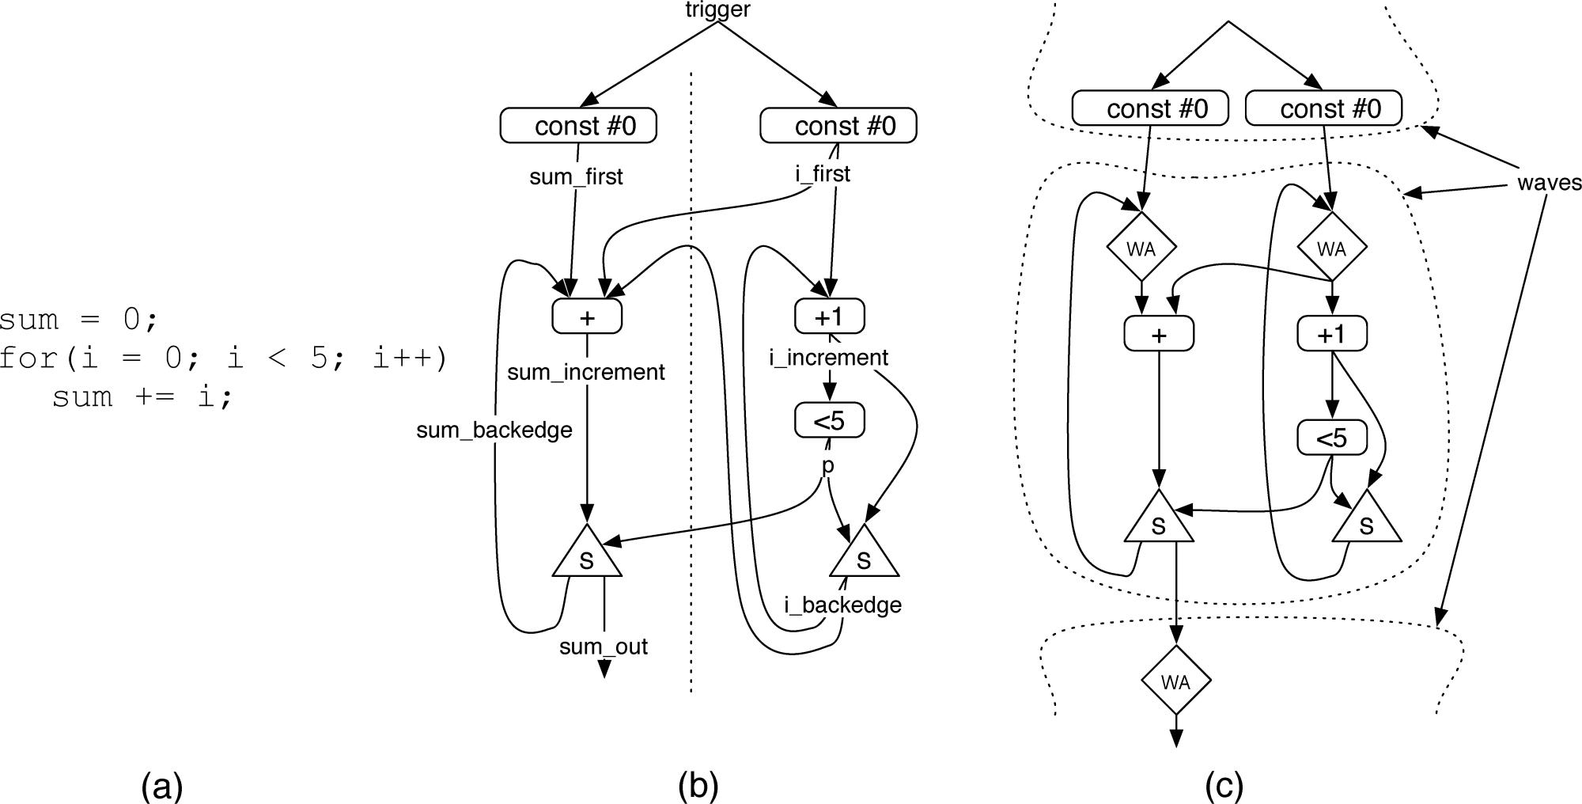
The WaveScalar ISA

Slide 11
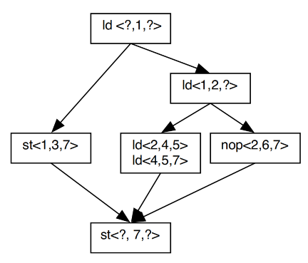
The WaveScalar ISA
Memory Ordering
Annotate each memory operation with its location in its wave
and its ordering relationships with other memory operations
link, < pred,this,succ >
Compiler ensures that sequence numbers
increase along any path through the wave.
For branch, use “?”
no gap rule, use”MEMORY-NOP”
wave-ordered store buffer
Notes:
Since dataflow ISAs only enforce the static data dependences in a program’s dataflow graph, they have no mechanism ensuring that memory operations occur in program order
wave的编译过程中会把内存指令之间的先后约束显现
相当于给内存指令编号

Slide 12
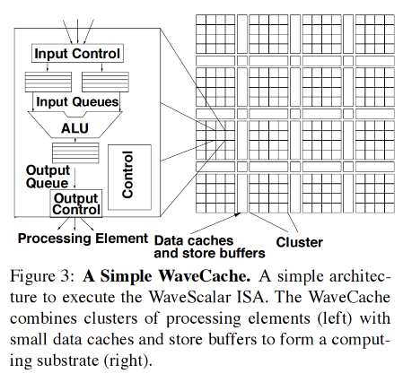
The WaveCache
Grid of processing elements for:
control instruction placement
input output queues
communication logic
functional unit
Cluster of 4 PEs:
L1 cache
Store buffer
Notes:
总结：WaveCache是一个有2kPE的结构，他又将每16个PE划分成一个cluster
每个PE有自己的指令控制逻辑，input output 队列，通信逻辑和运算单元。PE有自己的buffer和内存可以存8个不同的指令，那也就是说1整个wavecache可以存16K个指令，相当于RISC的64KB内存
input queue只需要一个读写port，并且根据当前的wave编号，同时会有一个小，多port的RAM来保存queue中每个实体的 full-empty bits
wave-cache对一个cluster中的每4个PE设置一个L1 data cache，L1通过L2cache进行对DRAM的访问
cluster内PE通过shared bus进行互相通信，在每个时钟末尾接收result。cluster的大小影响性能
对于cluster互相的通信，使用一个动态路由的NoC，每一个hop用一个cycle进行传递
在执行中，每一个指令绑定一个PE，但是一个PE可以绑定很多个指令。强调好的摆放位置，可以减少传递latency
同时每4个PE还有一个分布式store buffer，共享64个功能单元，每个动态的wave和这个buffer绑定（相当于shared mem？），所有的内存指令由这里发出。当store buffer结束后会signal切换下一个wave
关于如何将store buffer绑定到wave的问题，有两种方法。一种是加一条指令MEM-COORDINATE，让一个stroe-buffer去代表它的wave并把它的name传递到memory instructions离去，这样就带来了MEM-COORDINATE和所有内存指令的依赖，减少了并行
还有一种方法是用准村中的哈希表来将wave number来对应到store buffer。这样的话内存指令就会把request发送到最近的store buffer，buffer来判断mesaage该送到哪去。如果

Slide 13
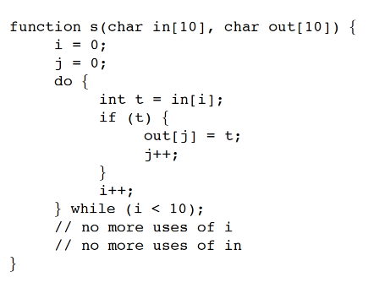
Example
Compilation
decompose the dataflow graph into waves
insert MEMORY-NOP instructions
assign sequence numbers to the memory operations
filling in the predecessor and successor fields
insert WAVE-ADVANCE instructions at the top of each wave for each live-in

Slide 14
Example
Encoding
Loading, finding, and replacing instructions
Execution
Termination

Slide 15
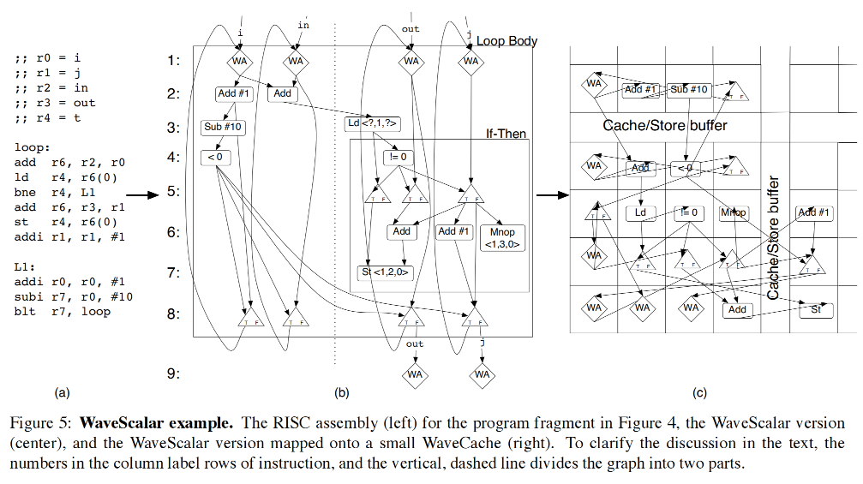
Example

Slide 16
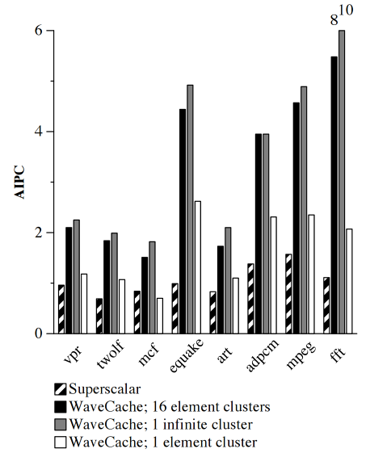
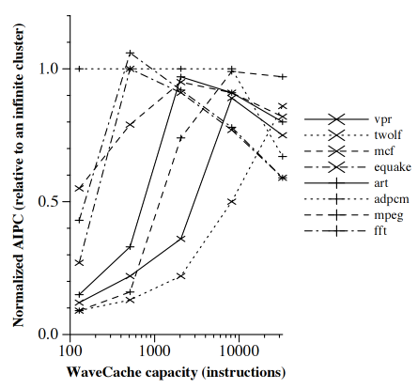
Results

Slide 17
Conclusion
“Scalable, low complexity, high performance”
Is it actually scalable? Compiler Scalability?
Dataflow driven rather than von neumann style linearity
Increase in parallelism
Compiler vs programmer responsibility
Superscalar and WaveScalar both split up the program into blocks
Multi-core systems - programmer's responsibility

Slide 18
Groq: A Tensor Streaming Processor (TSP) Architecture
For Accelerating Deep Learning Workloads

Slide 19
Background & Motivation
Size and complexity in AI algorithms
Demand for domain-specific architecture

Slide 20
Novelty
Slice
MXM
SXM
MEM
VXM
MEM
SXM
MXM
Functonal Slicing
Each tile stacked vertically implements a specific function
“slice” in the Y-dimension
Slice is controlled by specific instructions independently
Tile
Instruction Control Unit

Slide 21
Novelty
SIMD 16
MXM
SXM
MEM
VXM
MEM
SXM
MXM
Functonal Slicing
SIMD in slice’s tiles
ICU: decode and dispatch
Each slice implements a 20-stage vector pipeline
Each tile produces 16 elements.
20-stage
/
20-tile
SIMD 320
Instruction Control Unit

Slide 22
Novelty
Instruction Flow
Parallel lanes and Streams
Parallel lanes for slice’s SIMD exe
Steams for slice’ dataflow
Vertical flow(instruction)
Horizontal flow(data)
GPR -> Streaming Register File(SRF)
MXM
SXM
MEM
VXM
MEM
SXM
MXM
16 lanes
Superlane
Data
Flow
Notes:
两个都是编程抽象，parallel lanes 是设计每个slice内部的SIMD

Slide 23
Superlane
Matirx
execution
module
(MXM)
Swich execution module (SXM)
Memory Unit
(MEM)
Vector
execution model
(VXM)
Memory Unit
(MEM)
Swich execution module (SXM)
Swich execution module (SXM)
Matirx
execution
module
(MXM)
Swich execution module (SXM)
Memory Unit
(MEM)
Vector
execution model
(VXM)
Memory Unit
(MEM)
Swich execution module (SXM)
Swich execution module (SXM)
Instrucion Control
Instrucion Control
Instrucion Control
Instrucion Control
Instrucion Control
Instrucion Control
Instrucion Control
Instrucion Control

Slide 24
Inside the Superlane
6 instr
14 instr
44 instr
16 instr
44 instr
14 instr
6 instr
MXM
320MAC
×
16 Lanes
(INT/FP)
SXM
Transpose
Permute
Shift
MEM
44 Slices
×
128KB
(5.5MB)
VXM
16ALUs
×
16Lanes
MEM
44 Slices
×
128KB
(5.5MB)
SXM
Transpose
Permute
Shift
MXM
320MAC
×
16 Lanes
(INT/FP)
512B
512B
512B
512B
512B
512B
512B
512B
512B
512B
512B
512B

Slide 25
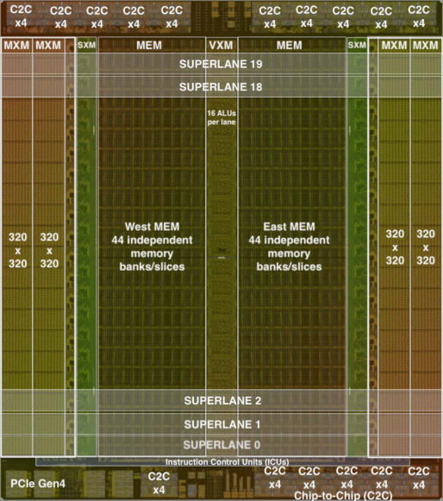
Architecture Overview
320-lane programming abstraction
16-lane unit as a “superlane”
144 independent instruction queues (ICUs)
64 logical streams
32 streams Eastward, 32 streams Westward
220 MiBytes of globally shared SRAM

Slide 26
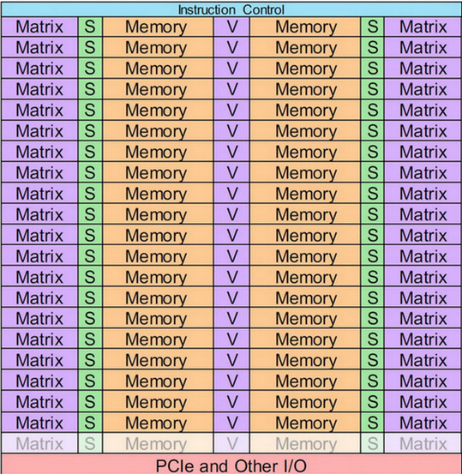

Slide 27
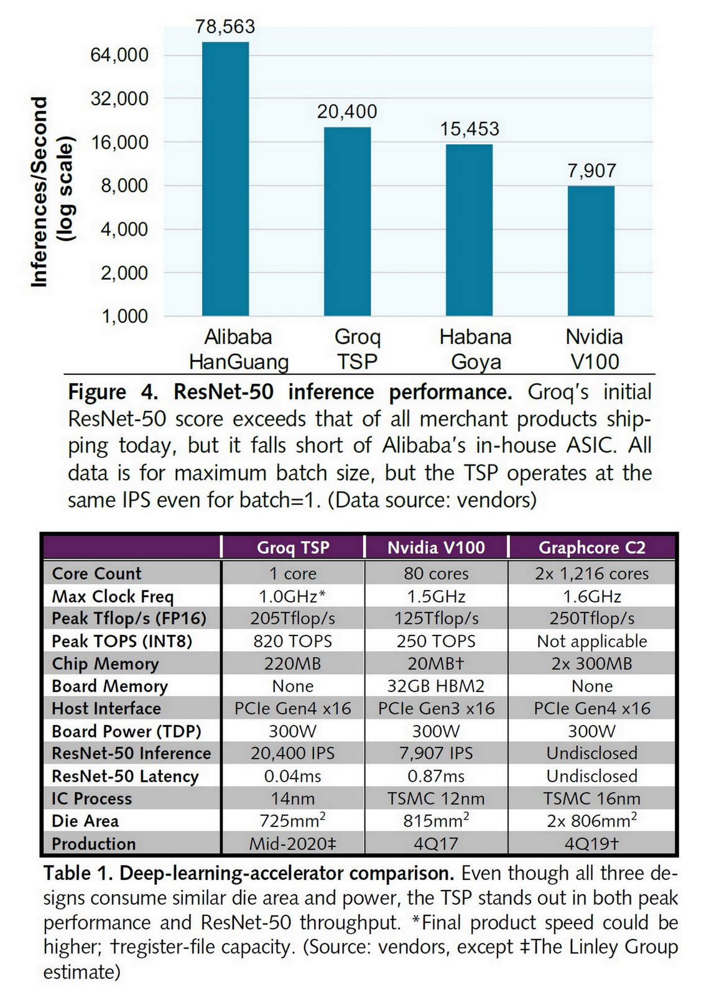
Evaluations

Slide 28
Difficulty in Coding
“144-wide statically scheduled VLIW machine comprising 320-byte SIMD units”
Fully utilizing its huge MAC arrays to compute various-size tensors is challenging.
Must enable customers to run production-level models on the TSP

Slide 29
Thanks!

